Slide 1
Name – Asif Anan
ID-1621358042
CSE 411
Section- 02

Slide 2
Project : Design an E-commerce Data warehouse

Slide 3
Task 1: Design the architecture of the warehouse and explain the sources, preprocessing, noise reduction, transformation and uploading.

Slide 4
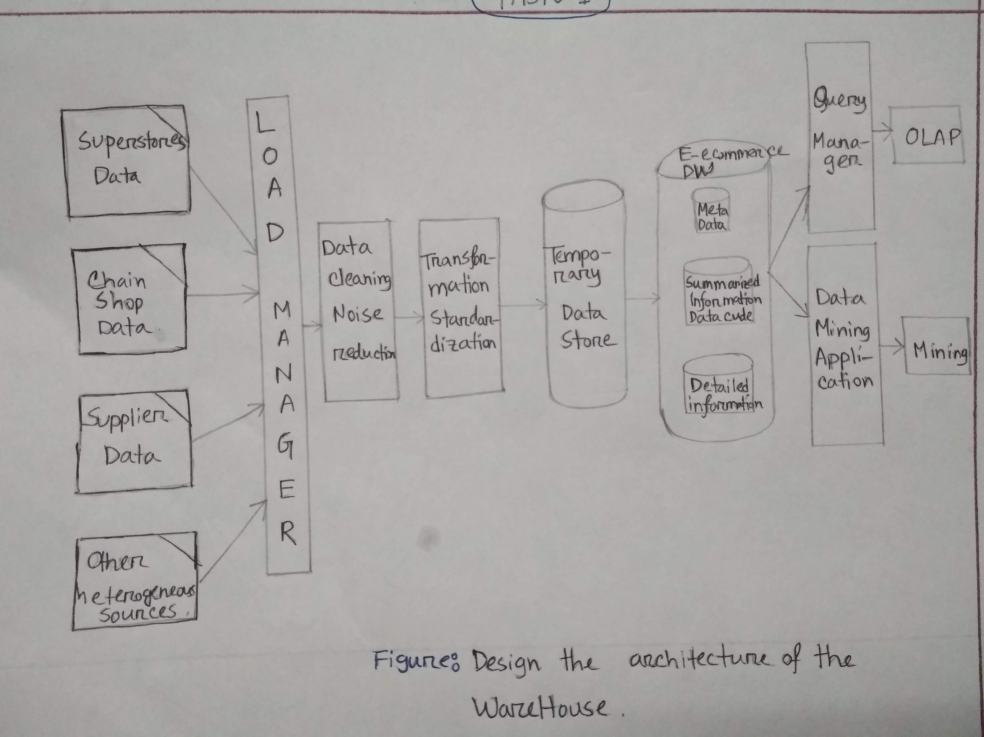

Slide 5
Task 2: Design the star schema for the warehouse and explain how the data of the superstore database will be collected to the DW (source driven or destination driven).

Slide 6
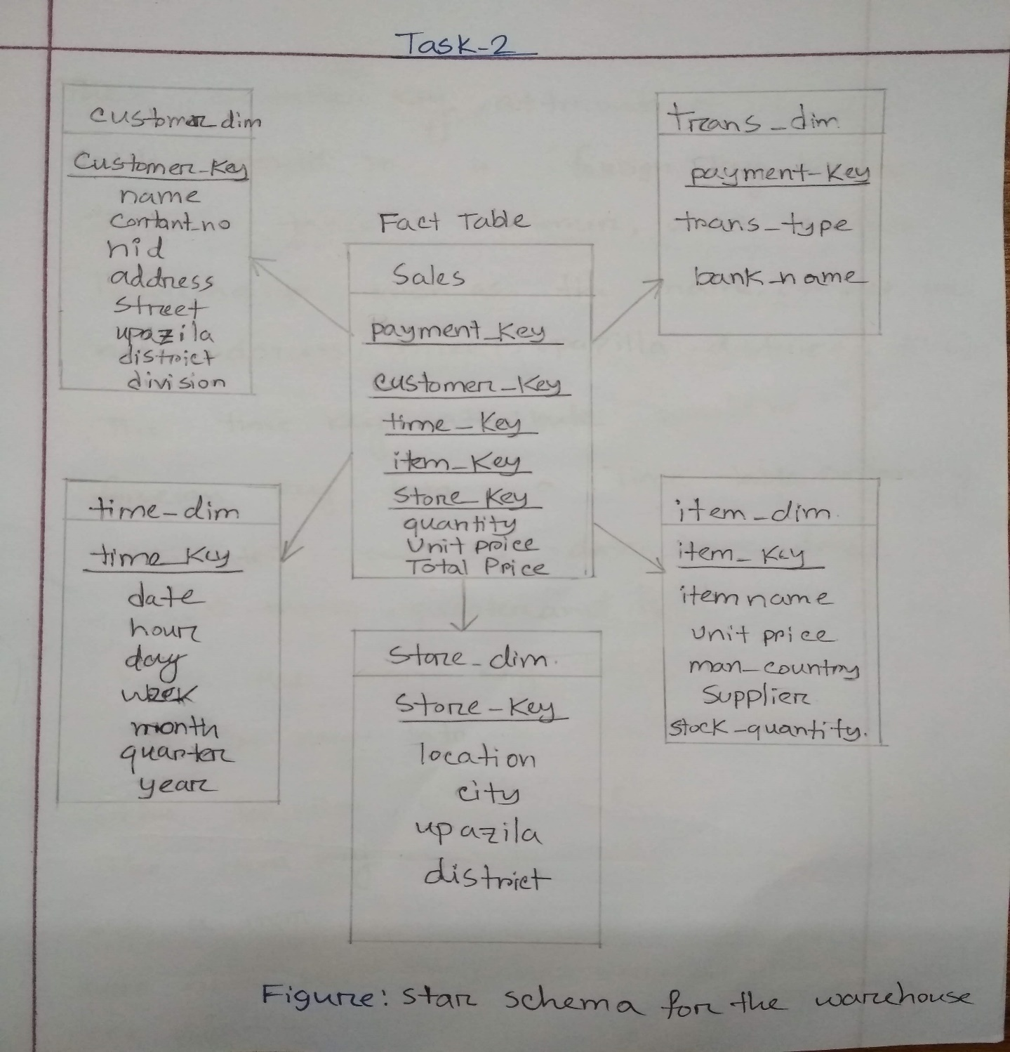

Slide 7
Task 3: Write three different cross tabulation for three different dimensions using total price/ quantity. Write SQL to find the cross-tabs.

Slide 8
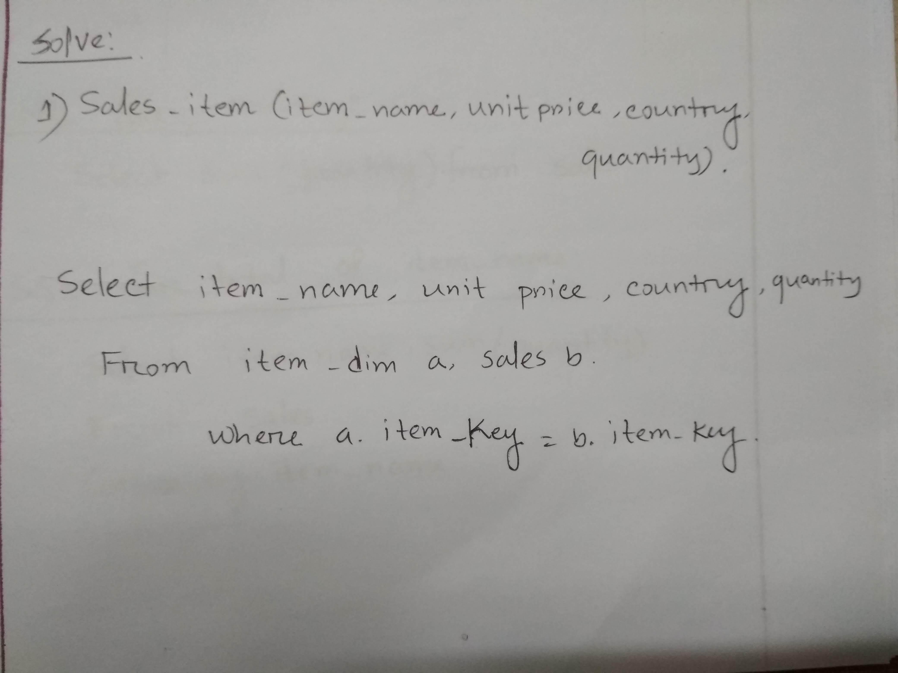

Slide 9
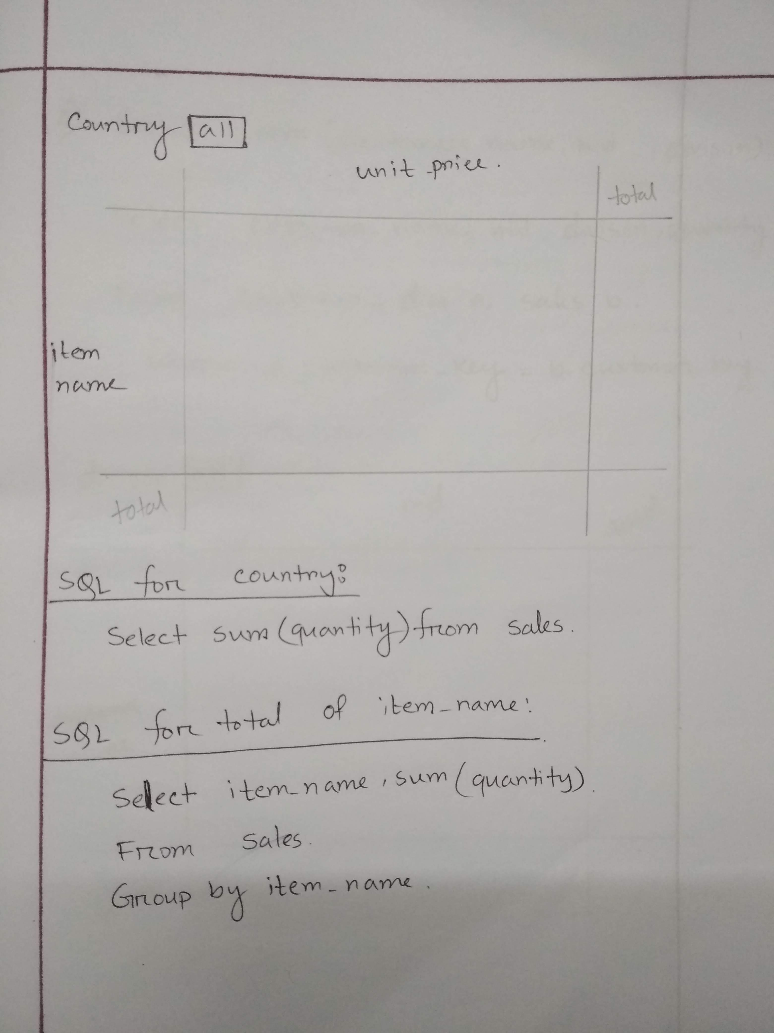
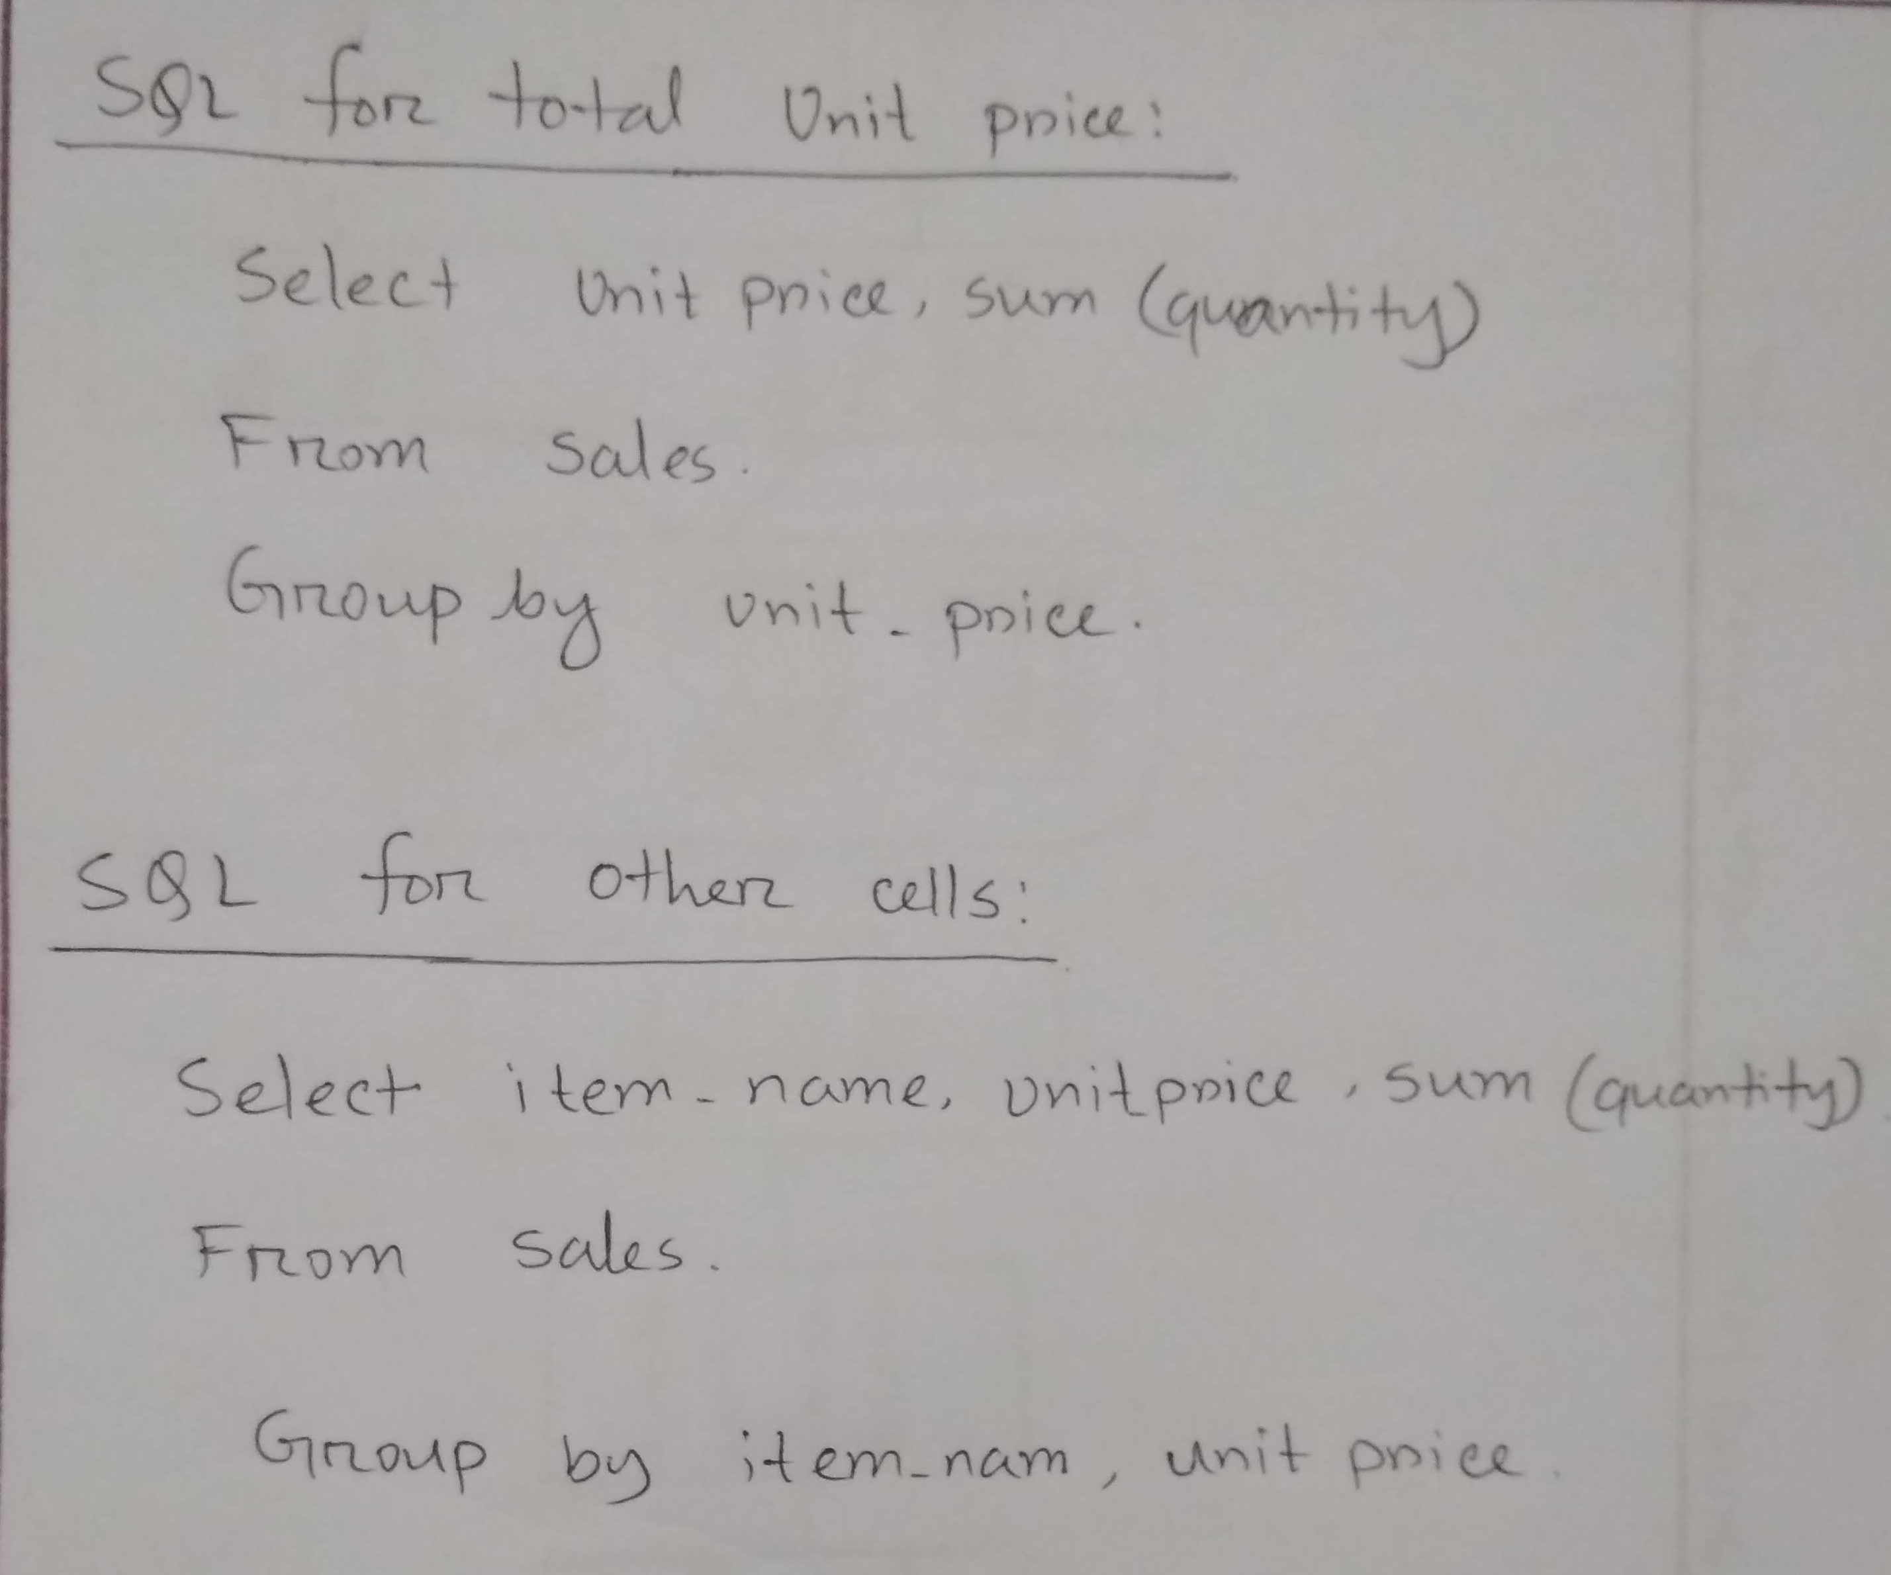

Slide 10
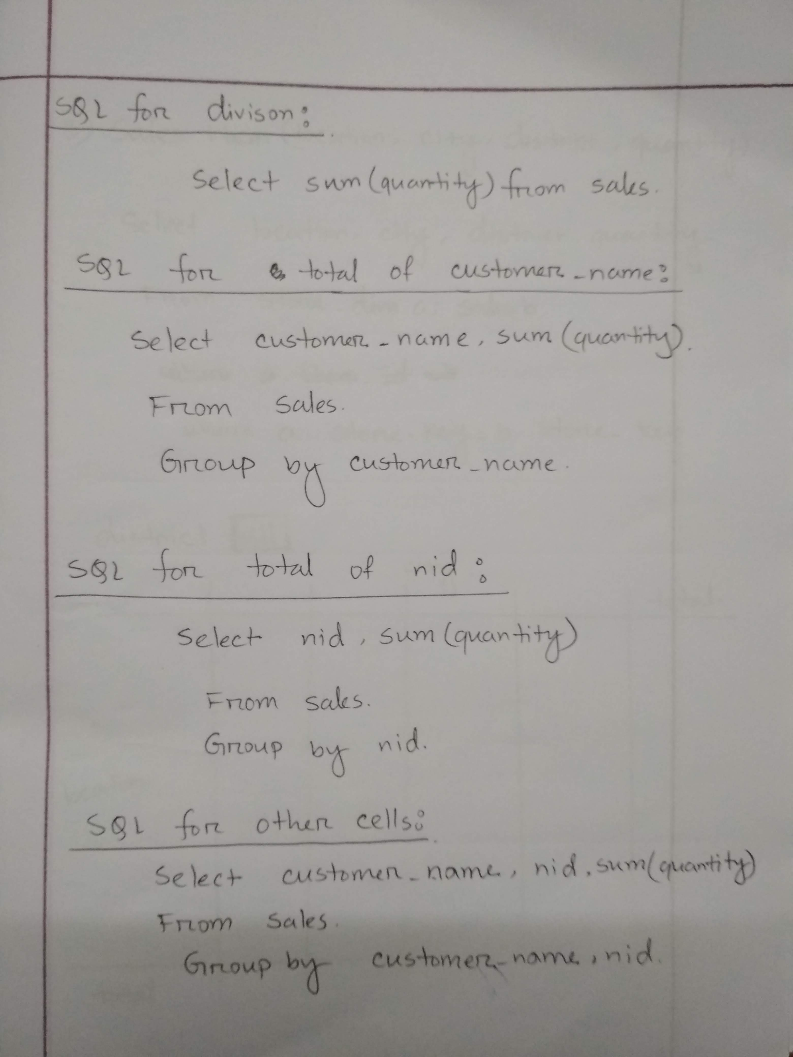
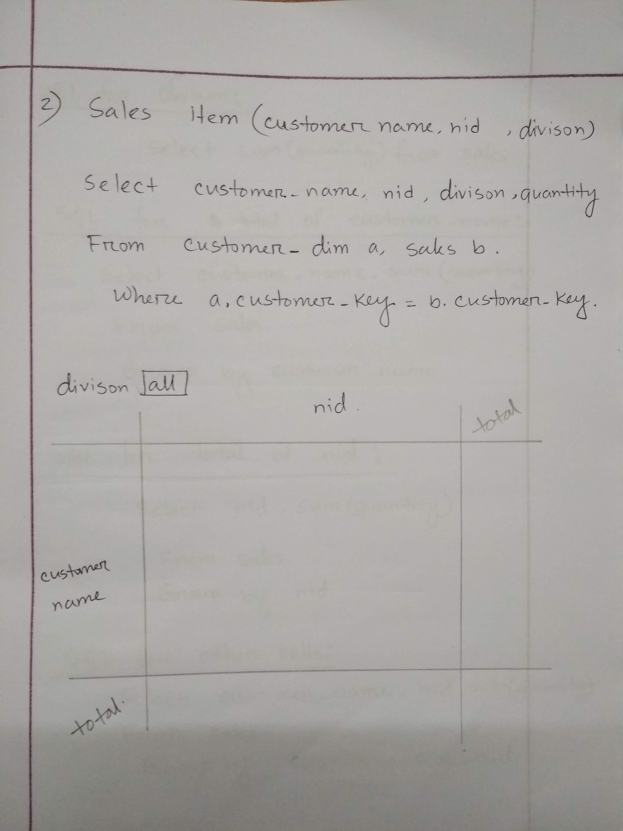

Slide 11
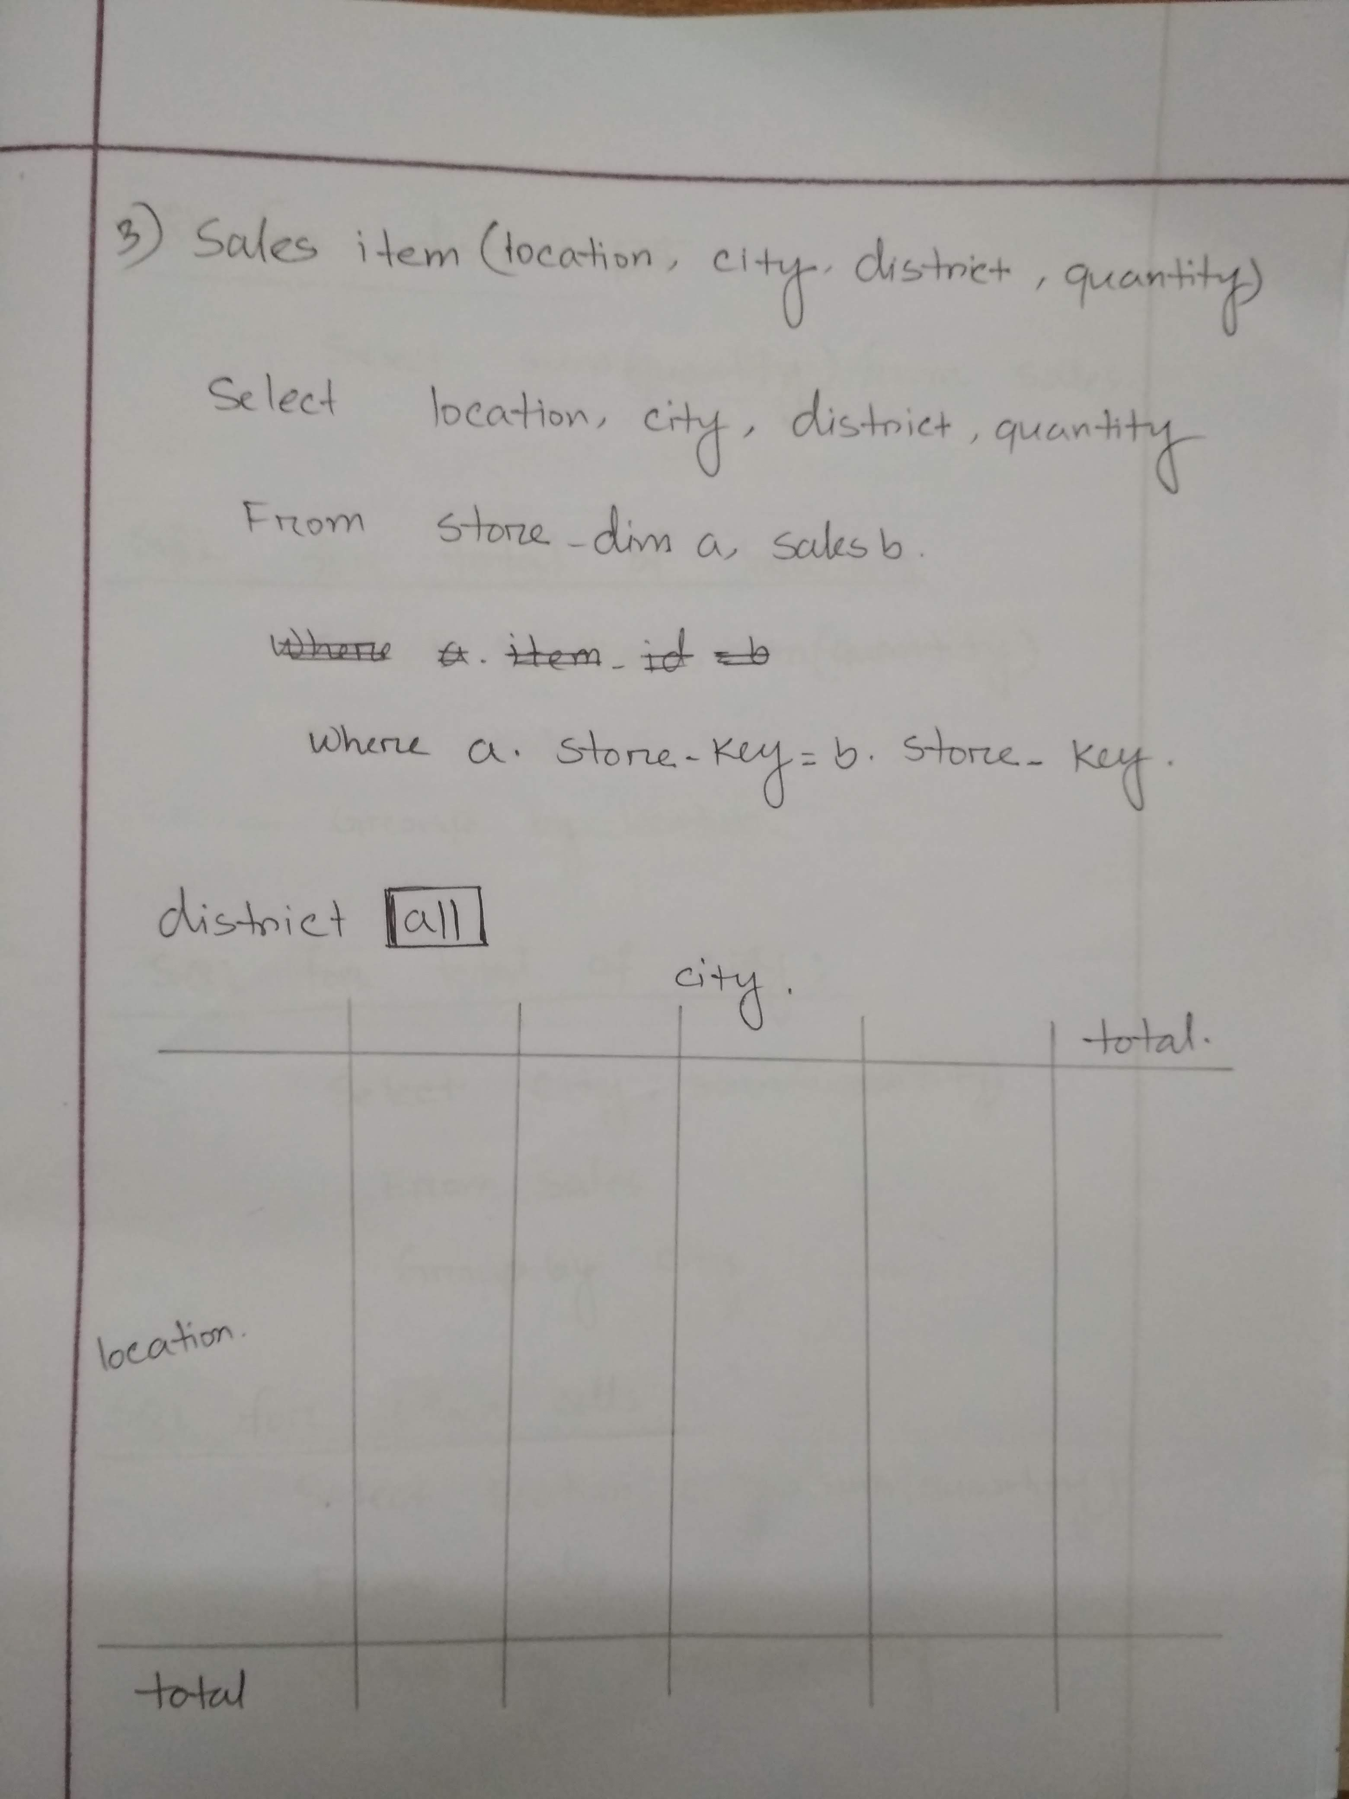
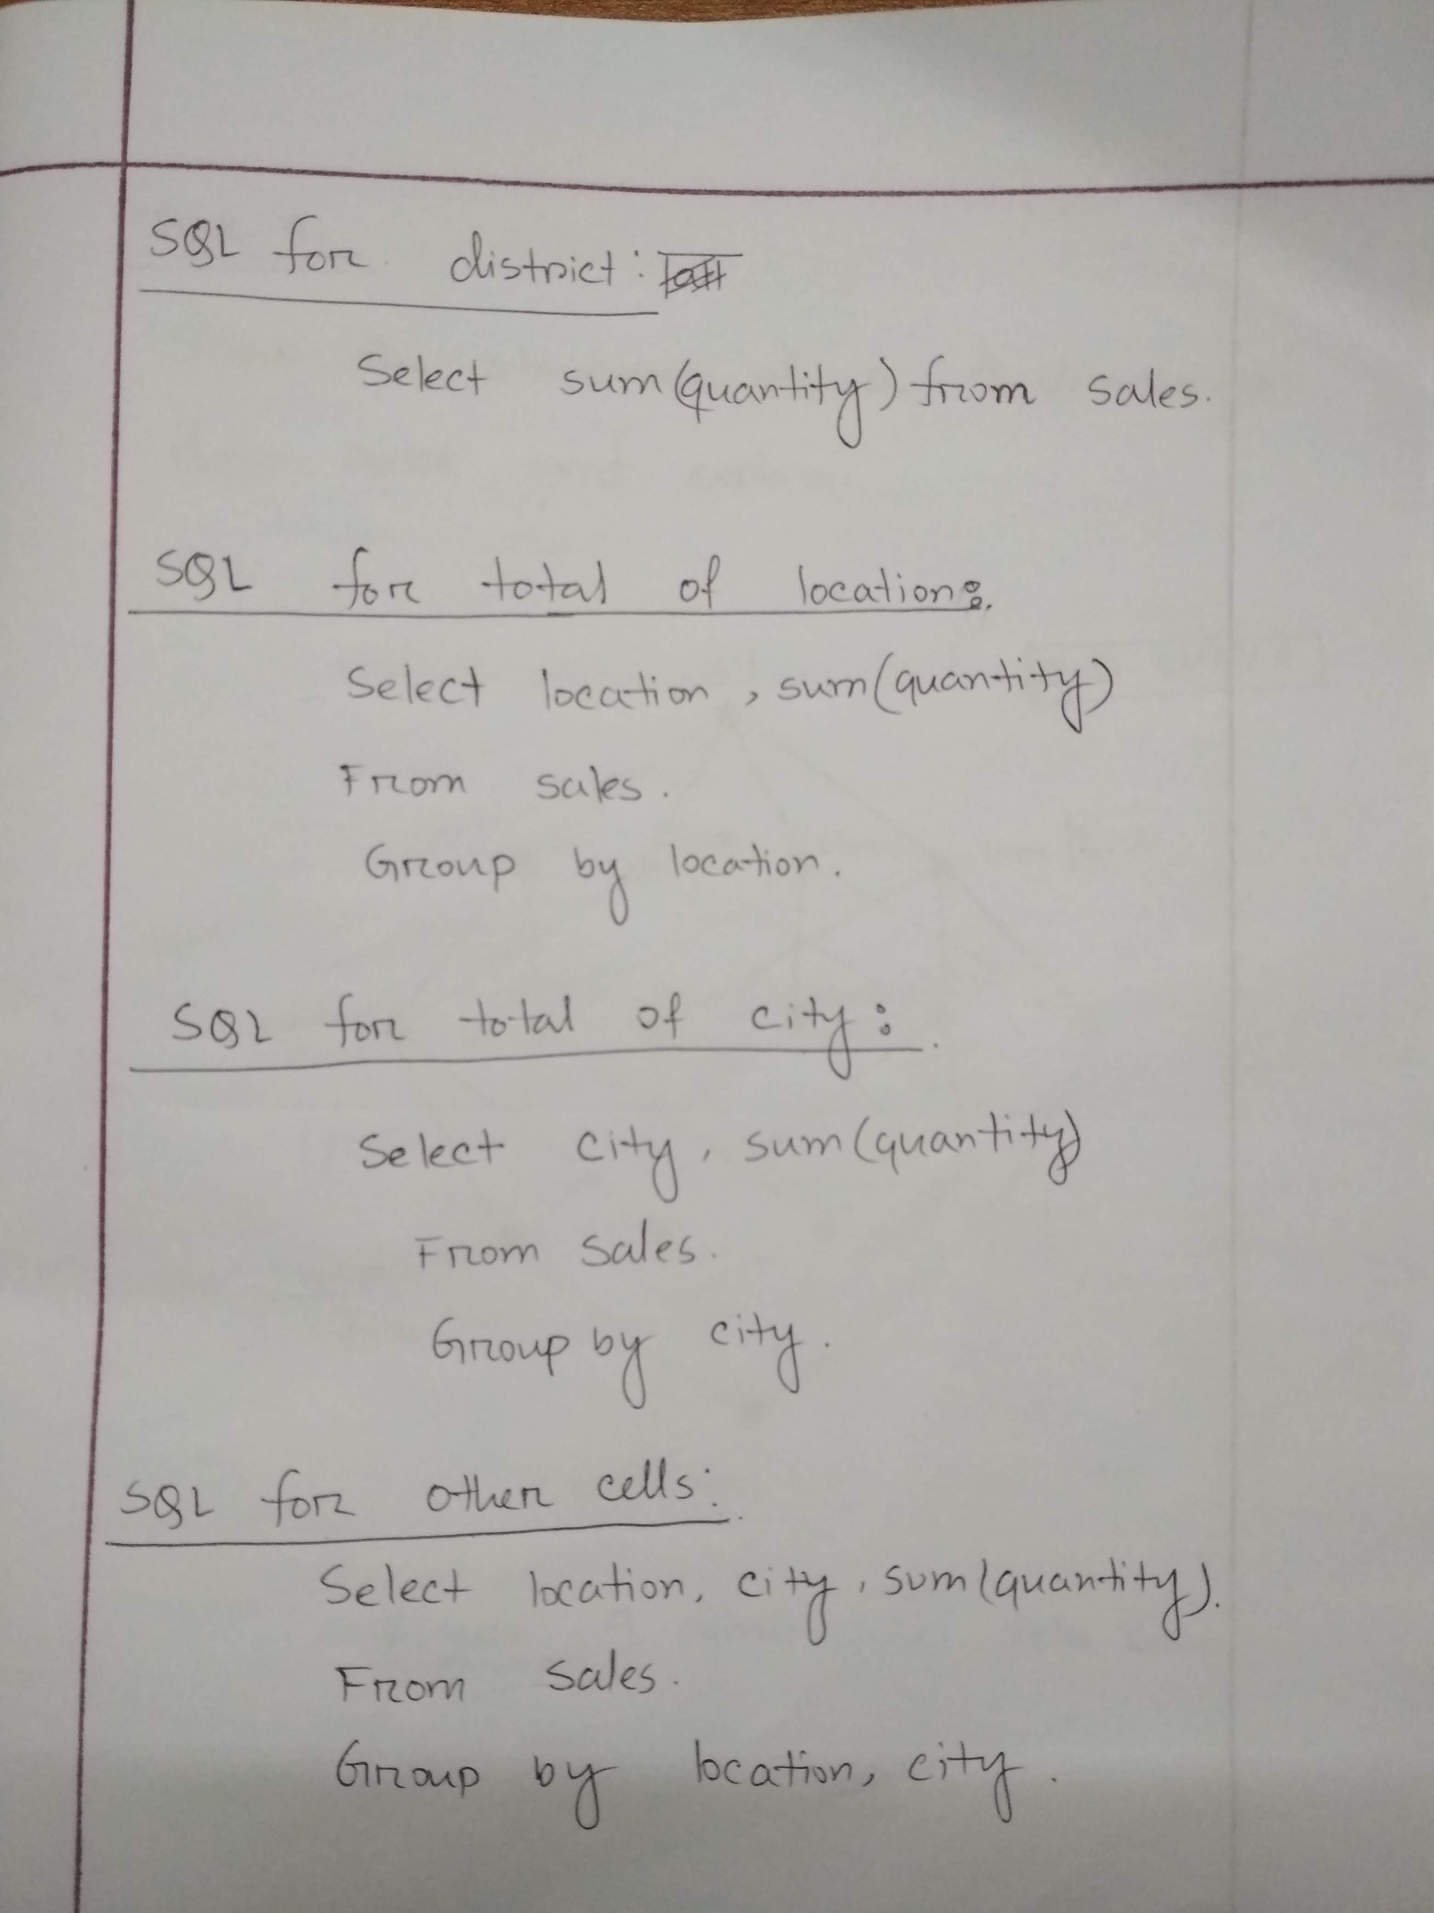

Slide 12
Task 4: Show the structure of a 4 dimensional data cube and explain.

Slide 13
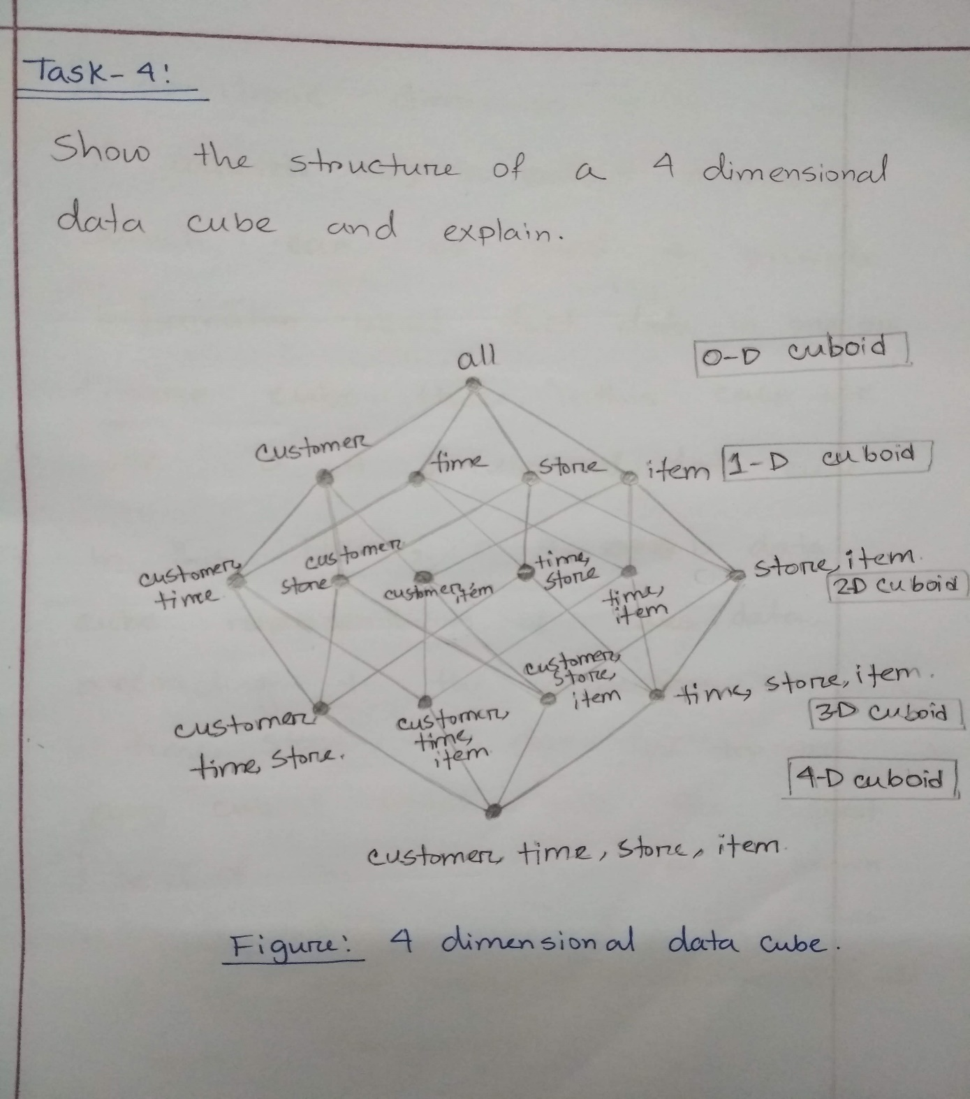

Slide 14
THANK YOU

